Slide 1

Finance for IT managers
International Masters
Spring 2025 program
© Sylvie Appriou

Slide 2
Case Study New Corp IT budget

Slide 3
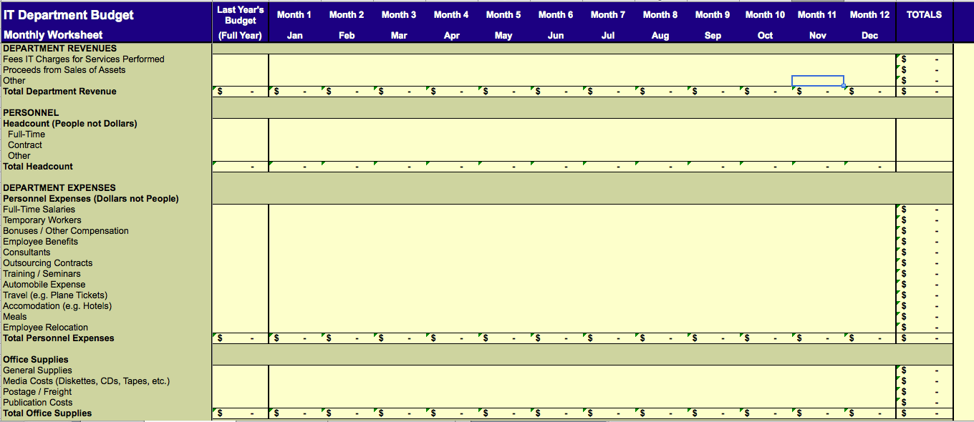
Budget model (1/3)

Slide 4
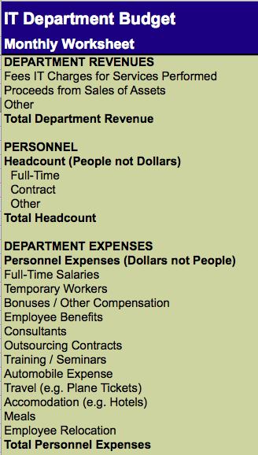
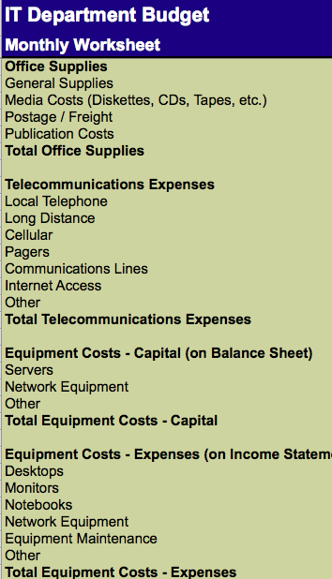
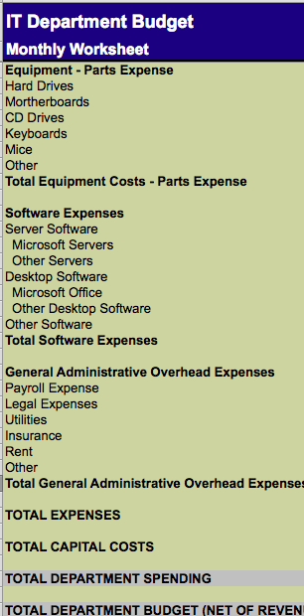
Budget model (2/3)

Slide 5
Case study details (1/4)
Despite the global economic climate, New Corp. has managed to continue growing at a slow pace for the past three years.
The outlook for 2015 is more favorable as New Corp. was short-listed on several large sales opportunities, which could materialize in 2015.
Your CEO anticipates business to grow faster than recently and plans on a 20% annual sales growth for next year.
New Corp. plans on growing the sales team by 15% and the rest of the organization by 10%
IT is key to New Corp.’s strategy, hence why you were recently hired
The company runs on an ERP system, implemented last year, after two previous unsuccessful attempts.
Your servers run at 78% capacity and despite a few data availability issues this year, your team seems to meet all SLAs.
The Marketing manager asked to meet with you next week, as she wants to discuss the revamping of New Corp.’s web site with you.

Slide 6
Case study details (2/4)
In addition of supporting the growing business with your IT department, your CEO mentioned during your interview that:
He would like to invest into an HR system to automate all HR activities and provide an HR tool to all managers. Your CEO already knows from a friend of his (President of a large software company specialized in HR packages) that he could implement their HR system for less than 120,000USD, within 9 months, with the addition of contractors and consultants.
He is frustrated at sales representatives keeping all of their sales contacts and sales forecast data privately on their own laptops. The loss of key sales data hurt New Corp. severely last summer when the most senior and performing sales representative left the company.
He trusts you for making a full assessment of the IT situation and come up with recommendations on where you see priorities and opportunities to reduce costs and improve productivity.

Slide 7
Case study details (3/4)
You met individually with all of your permanent team members and gathered that one person on your team is keen on moving into project management, with additional training. Another person on your team has indicated she is interested into moving to HR as a future career move.
Bob, the sales manager you met at the first leadership meeting has been very vocal about the need to equip his entire sales representatives with iPads to have access to sales and technical information at all times, to be able to forecast when visiting customers. Your CEO doesn’t seem to have a clear position on the question but doesn’t seem able to say “no” to Bob.
You already started planning the requested implementation of the HR system into your budget with the addition of 1 full-time consultant from March and 5 contractors between June and November. You haven’t yet included any of the software license, equipment or non-personnel costs into your budget. You also expect to learn more from meeting with the HR manager soon. You are also considering some of the SaaS solutions available on the market, as a way to speed up implementation time frames and reduce CapEx expenditure.

Slide 8
Case study details (4/4)
You will end 2014 with a team of 8 people (Cell B14 on tab 2), yourself included.
Your CEO didn’t mention this directly to you but you are aware of the idea of an acquisition being discussed at board level. You don’t know much about the potential targets but heard that foreign companies were being considered.
Finally, in your previous job, you had participated in the very successful implementation of a corporate data warehouse and BI solution, which you believe contributed to a 10% growth in sales and 25% cost reduction.

Slide 9
Questions on the Budget model
Looking at the budget model Monthly worksheet (Excel) :
What does the 180,000 in cell B4 represent ?
How many Full time employees, contractors do you have in your department at the end of the year ?
How was the 325,000 in cell B18 was calculated ?
Same question for 255,000 in cell B23

Slide 10
Questions on the Budget model
Looking at the budget model Monthly worksheet (Excel) :
What does the 180,000 in cell B4 represent ?
180,000 is the amount IT department recharge to other departments for their services. This is a revenue to IT.
As per the comment in cell P4, we know that IT charges to other departments 150$ / month / employee
Monthly revenue is therefore 15,000$ and we know that company has 100 employees…

Slide 11
Questions on the Budget model
Looking at the budget model Monthly worksheet (Excel) :
What does the 180,000 in cell B4 represent ?
How many Full time employees, contractors do you have in your department at the end of the year ?
At the end of the year, there are 5 full time employees and 3 contractors as per cells B11 and B12
This is the headcount baseline

Slide 12
Questions on the Budget model
Looking at the budget model Monthly worksheet (Excel) :
What does the 180,000 in cell B4 represent ?
How many Full time employees, contractors do you have in your department at the end of the year ?
How was the 325,000 in cell B18 was calculated ?
325,000 is the total salary for full time employees
Given that there are 5 employees the average yearly salary per employee is 65,000 / year, assuming that all employees have been present for the full year

Slide 13
Questions on the Budget model
Looking at the budget model Monthly worksheet (Excel) :
What does the 180,000 in cell B4 represent ?
How many Full time employees, contractors do you have in your department at the end of the year ?
How was the 325,000 in cell B18 was calculated ?
Same question for 255,000 in cell B23
Similar as previous question, 255,000 is the total cost for the 3 contractors
Assuming that all contractors have been present for the full year, this gives a yearly contractor cost of 85,000

Slide 14
Questions on Case study narrative
Reading the Case study narrative (ppt) :
How would you rate the upcoming year general business environment and why ? Very Good, Good, Average, Bad or Very Bad…
Which candidate projects have you identified for for the upcoming year ?
How do you see your department headcount evolve in the upcoming year : should it increase, decrease or stay the same ? Why ?
How would you react when one of your employees mentions h/she wants to move to the HR department ?
Do you think your budget for the upcoming year will be higher, lower or the same as last year ? Why ?

Slide 15
Questions on Case study narrative
Reading the Case study narrative (ppt) :
How would you rate the upcoming year general business environment and why ? Very Good, Good, Average, Bad or Very Bad…
General business environment for the upcoming year looks good or even very good…
Company is growing and top management anticipates a faster growth (20%) in the coming year
Some large sales opportunities could materialize as company was short listed on several large deals
Sales team should grow by 15% and the rest of the organization by 10%

Slide 16
Questions on Case study narrative
Reading the Case study narrative (ppt) :
Which candidate projects have you identified for for the upcoming year ?
HR system
Sales Forecast system
Re-vamping of NewCorp website
Full assessment of IT with recommendation of priorities / opportunites to reduce costs and improve productivity
iPads for sales representatives
Acquisition
Data warehouse and BI system

Slide 17
Questions on Case study narrative
Reading the Case study narrative (ppt) :
How do you see your department headcount evolve in the upcoming year : should it increase, decrease or stay the same ? Why ?
My department headcount will increase for the 2 following reasons
Company growth : plan is for non sales department to grow by 10%. As a results IT should grow by at least 10% to support on going activities and the growing number of employees in the company
Projects : additional headcount will be required to support the prioritized projects. Of course depending on which projects are included in the budget

Slide 18
Questions on Case study narrative
Reading the Case study narrative (ppt) :
How would you react when one of your employees mentions h/she wants to move to the HR department ?
I will tell the employee that I fully support his/her development and therefore I will support the transition to another department
However, timing will need to be negotiated as I need time to find a replacement for the position left empty
Time to get an internal employee to fill in the position or to hire from outside could be easily 3 months…

Slide 19
Questions on Case study narrative
Reading the Case study narrative (ppt) :
Do you think your budget for the upcoming year will be higher, lower or the same as last year ? Why ?
As a result of question 3 : headcount will grow by at least 10% IT budget will increase to reflect :
The at least 10% headcount growth
Projects that will require extra funding

Slide 20
Thank you!
See you next time

